Slide 1

INFM 603: Information Technology and Organizational Context
Session 1: Physical and Web Infrastructure
Jimmy Lin
The iSchool University of Maryland
Thursday, September 11, 2014

Slide 2
Introduction (How I got here)

Slide 3


From the Ivory Tower…
Source: Wikipedia (All Souls College, Oxford)

Slide 4
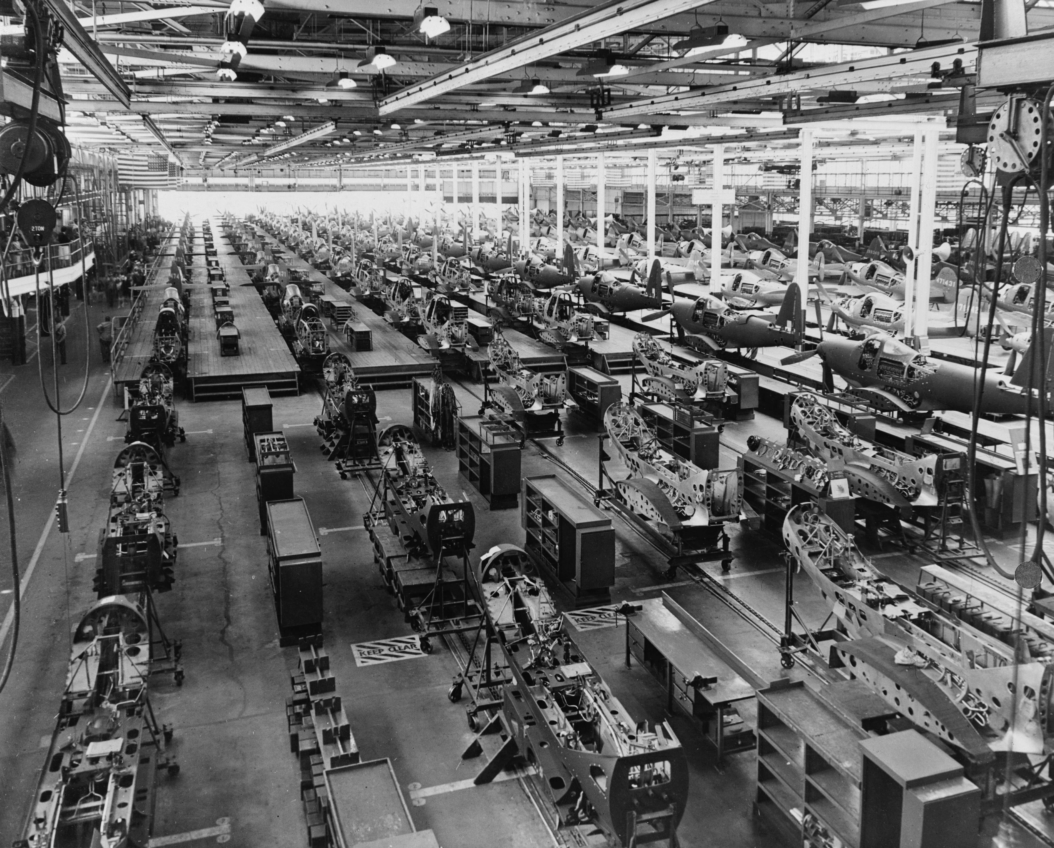

… to building sh*t that works
Source: Wikipedia (Factory)

Slide 5
… and back.
Source: Wikipedia (All Souls College, Oxford)

Slide 6
Introduction (How you got here)

Slide 7
This course has a lot of programming
This course is about core computing concepts
(but the goal is not to make you into a programmer)
The point is about understanding technology
in the context of solving real-world problems
(the ability to apply core concepts to changing circumstances)
(BTW, do you belong here?)

Slide 8
A brief history… (How computing got here)

Slide 9
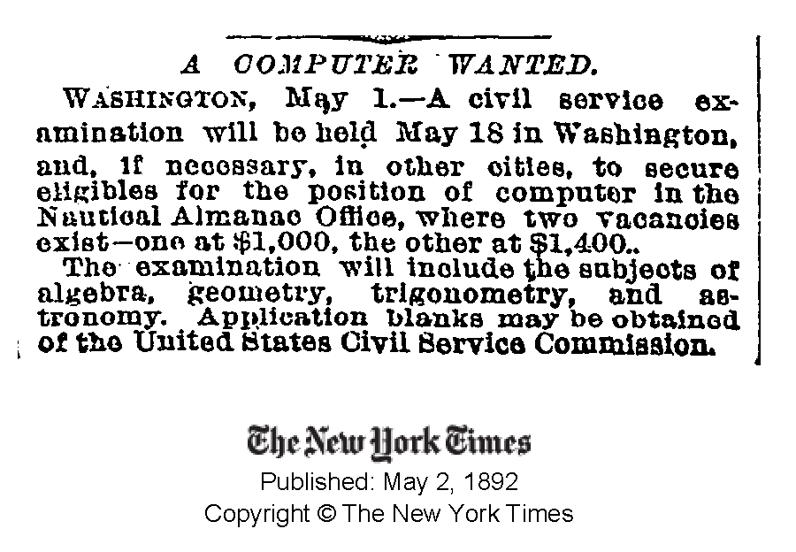

Slide 10
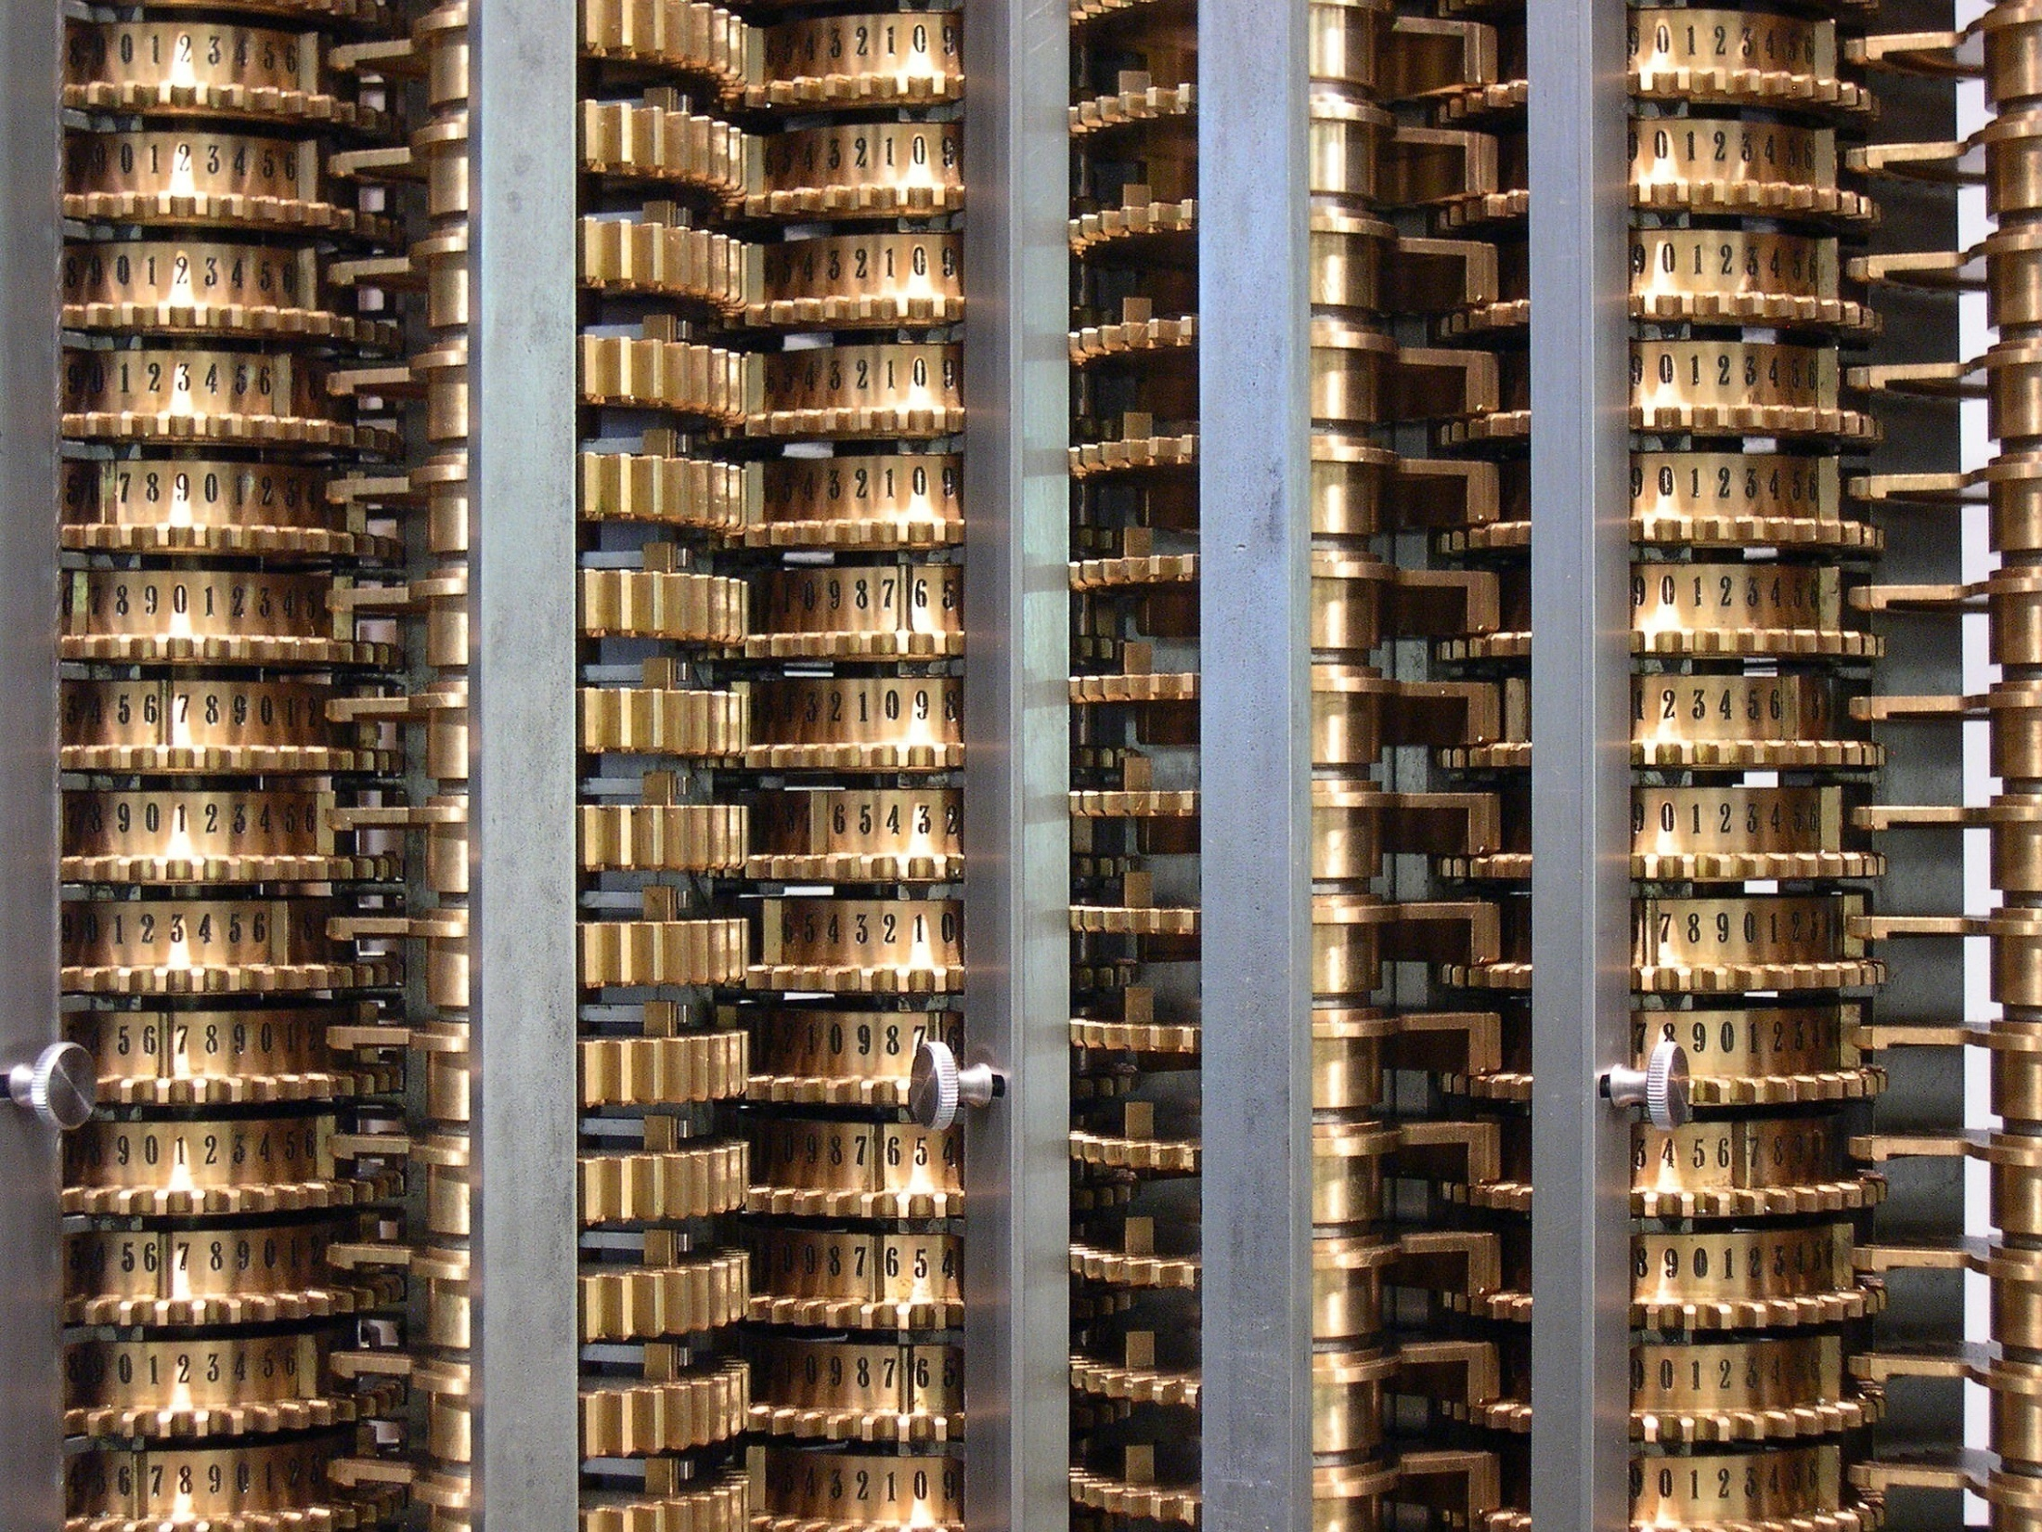
Source: Wikipedia (Difference engine)

Slide 11

Source: Wikipedia (ENIAC)

Slide 12
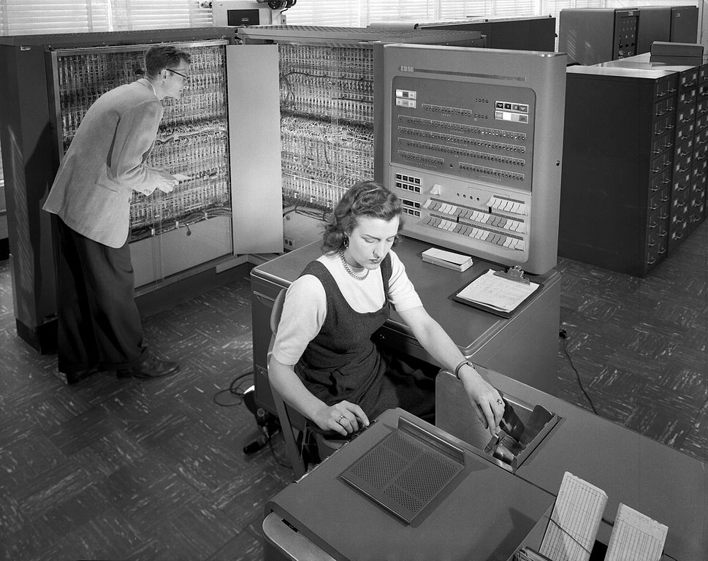
Source: Wikipedia (IBM 704)

Slide 13
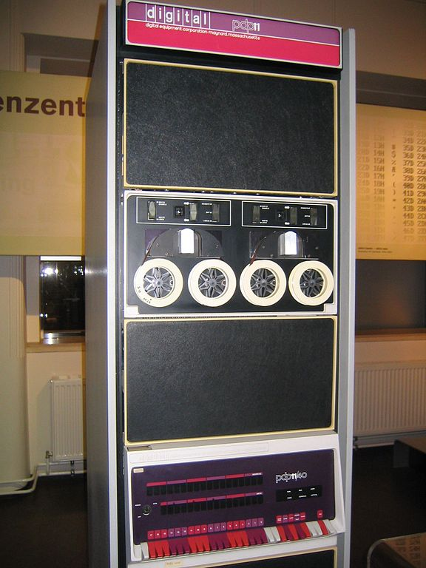
Source: Wikipedia
Source: Wikipedia (PDP-11)

Slide 14

Source: Wikipedia (Personal computer)

Slide 15

Source: Wikipedia

Slide 16
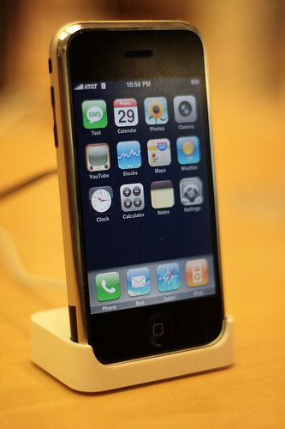
Source: Wikipedia

Slide 17
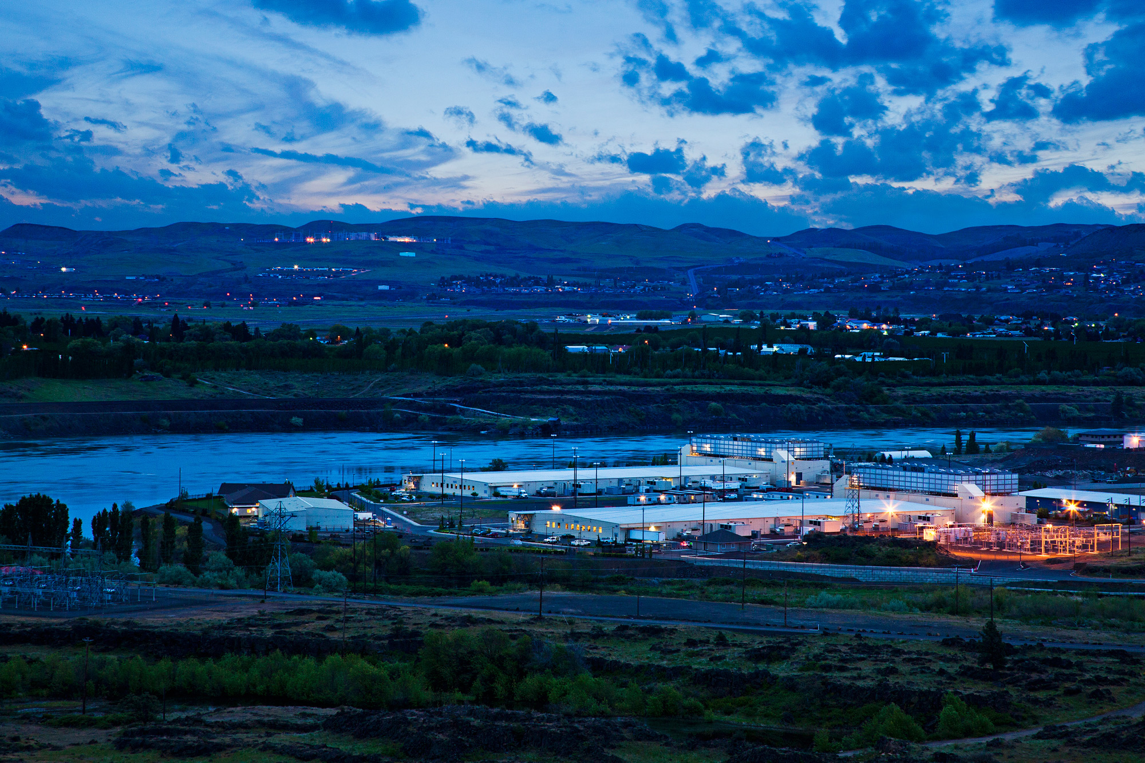
Source: Google

Slide 18
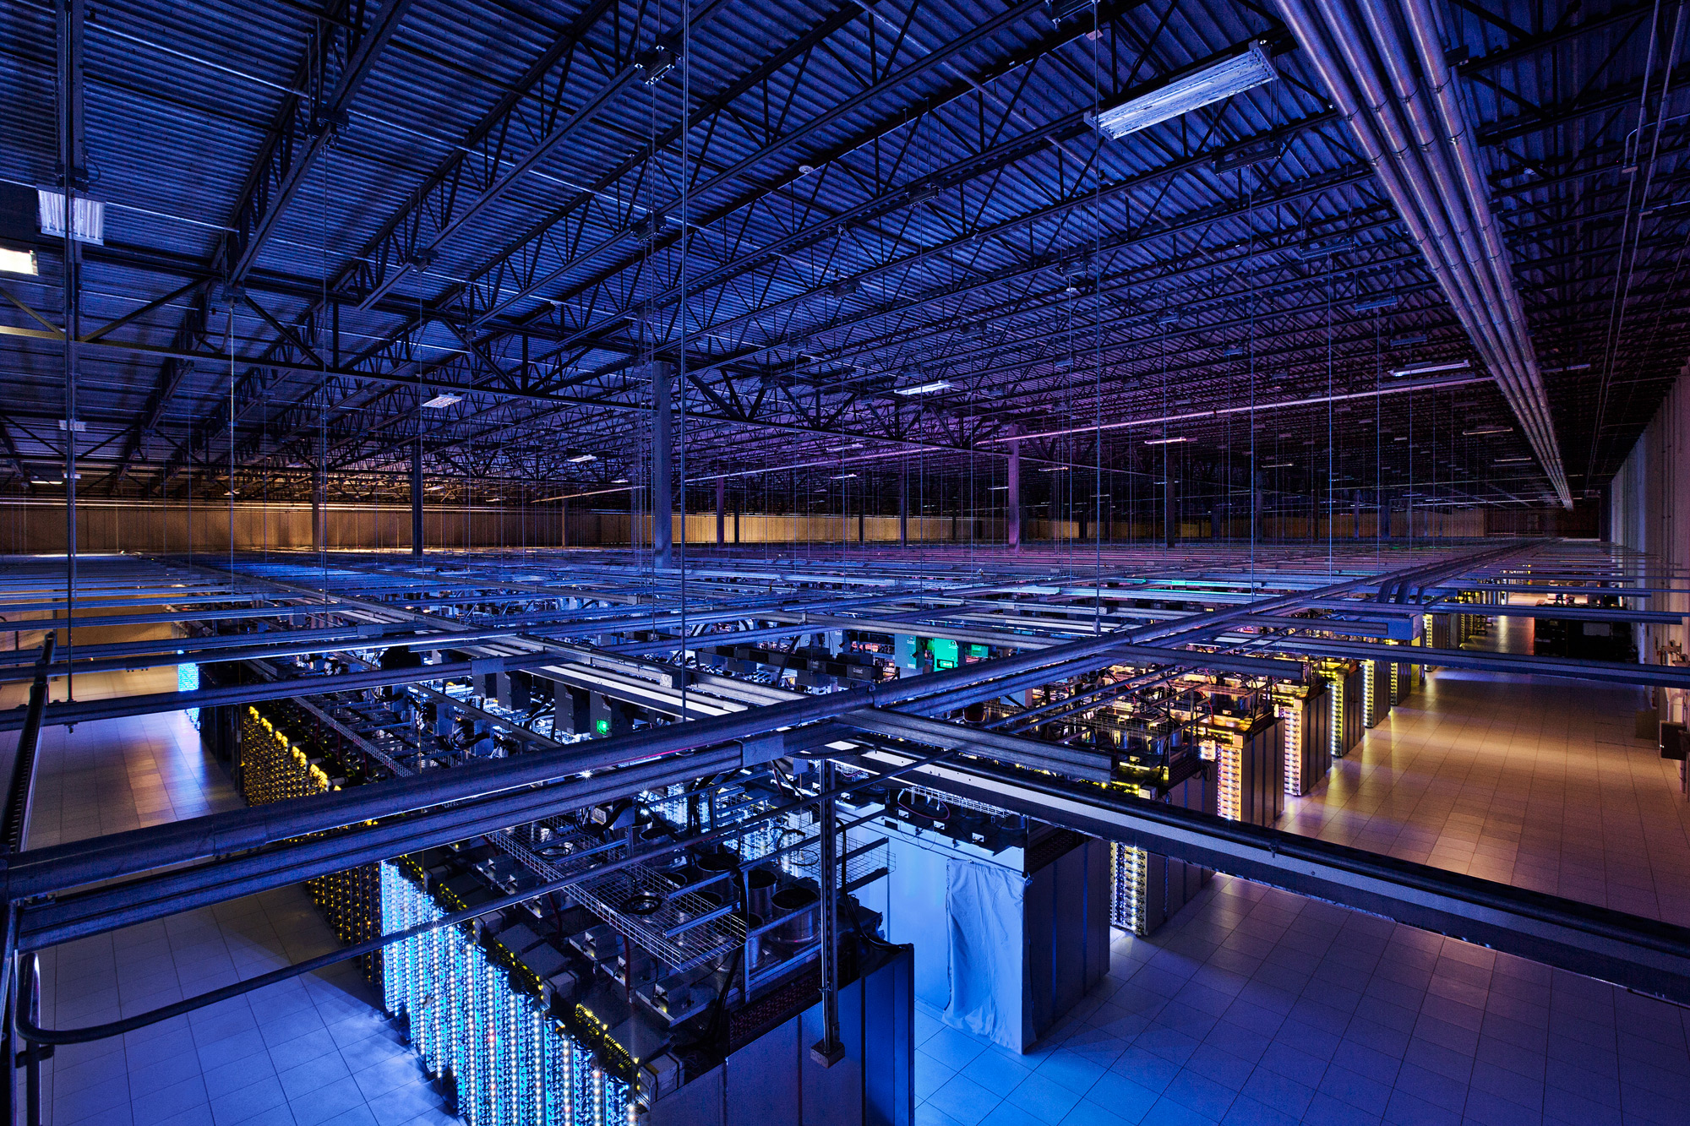
Source: Google

Slide 19
What is a computer?
Memory
Processor
Output
Input

Slide 20
The Processing Cycle
Input comes from somewhere
Keyboard, mouse, touchpad, touch screen, microphone, camera, …
Fetch data from memory
The computer does something with it
Add, subtract, multiply, etc.
Output goes somewhere
Monitor, speaker, printer, robot controls, …
Store data back into memory

Slide 21
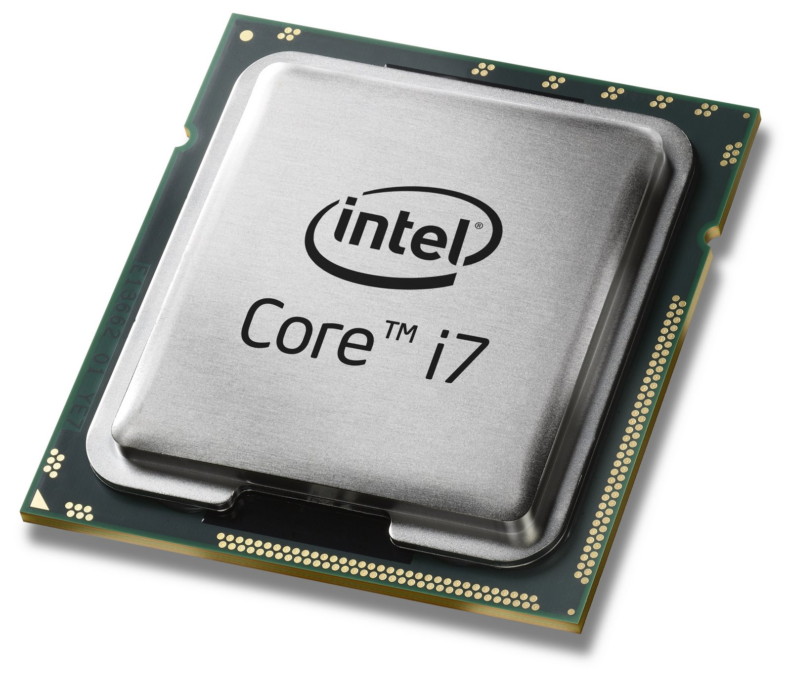
Source: Intel

Slide 22
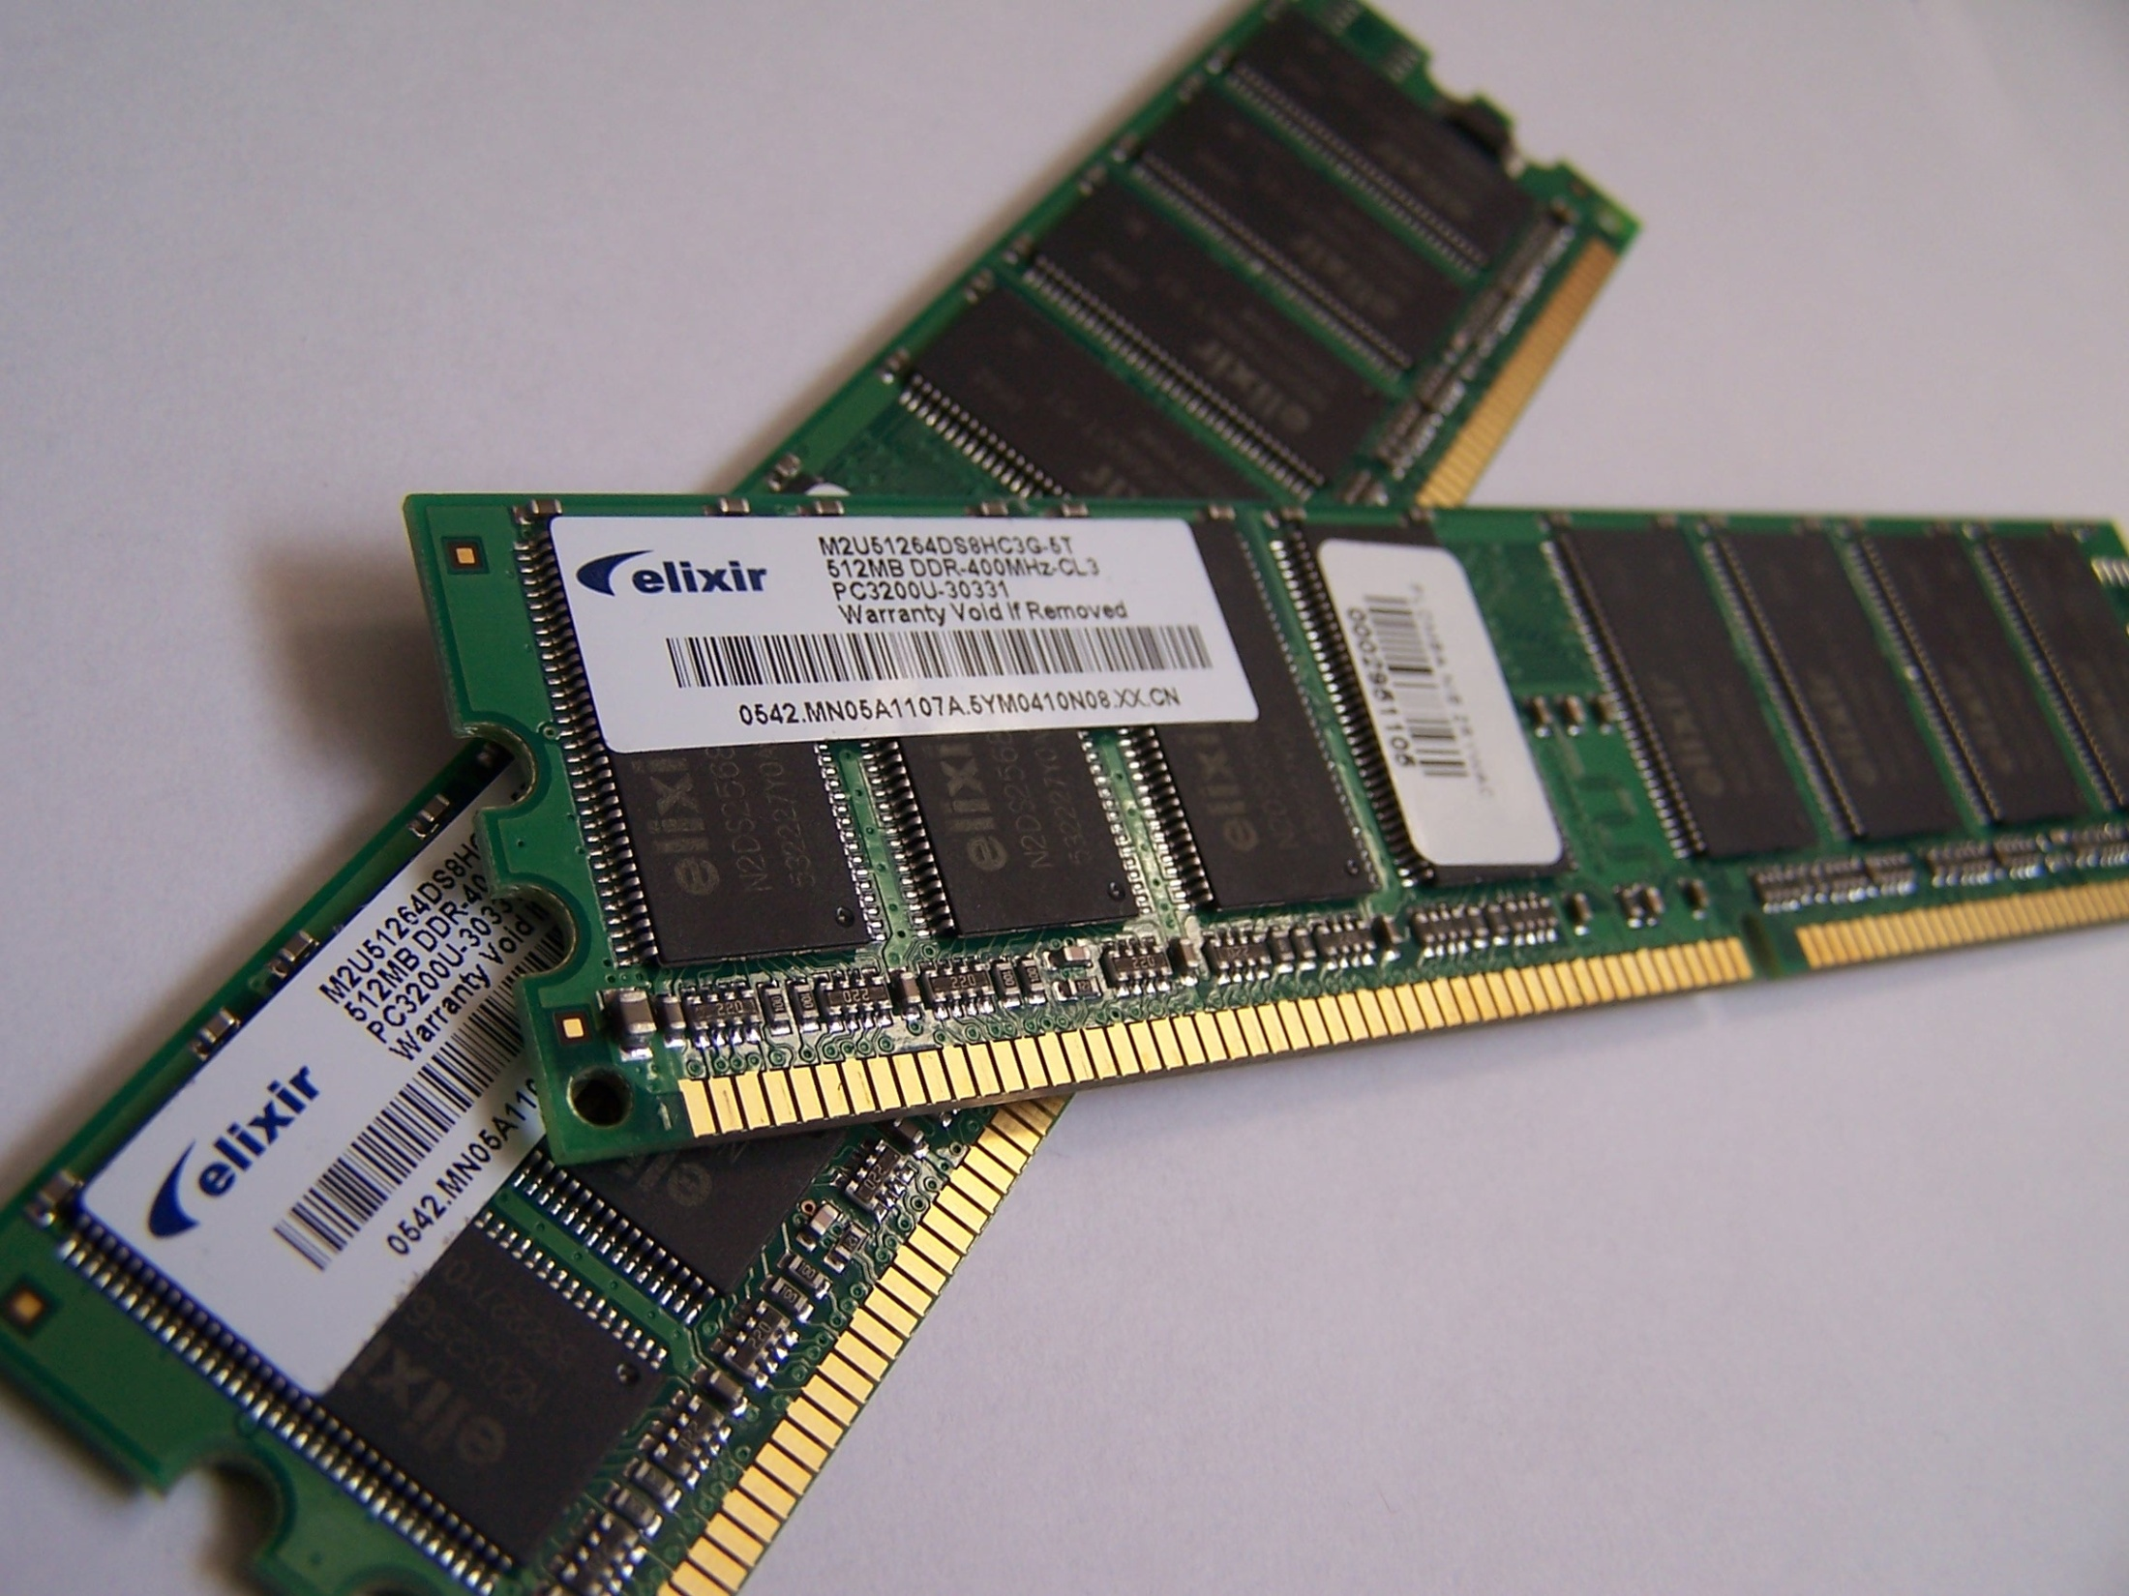
Source: Wikipedia (Random-access memory)

Slide 23
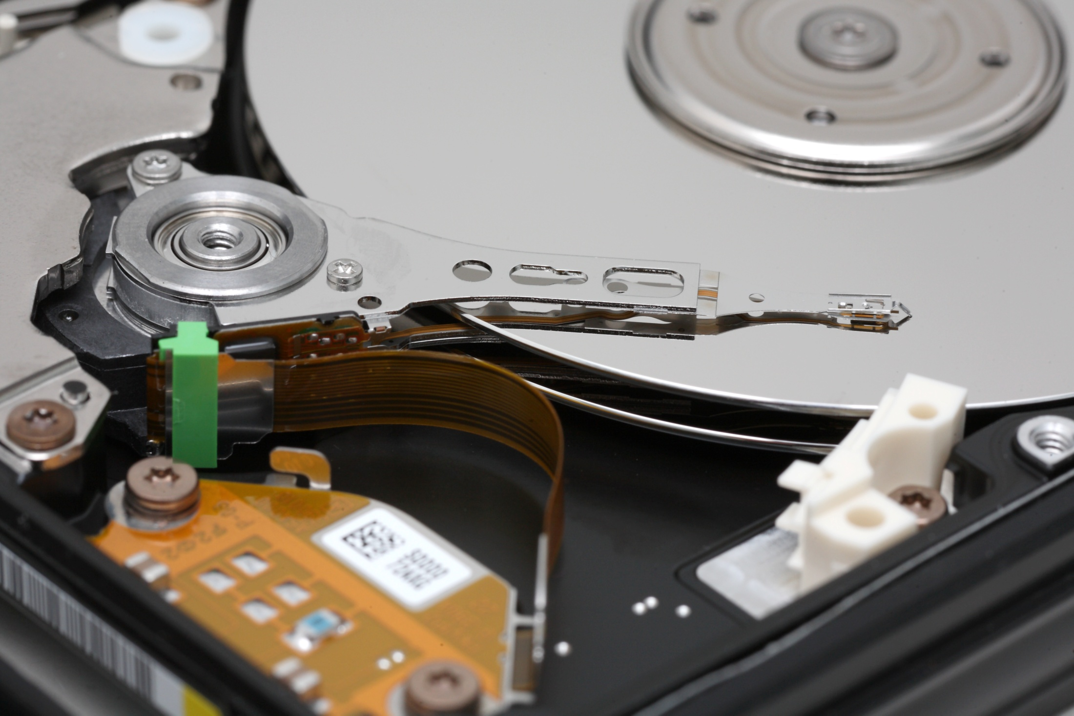
Source: Wikipedia

Slide 24
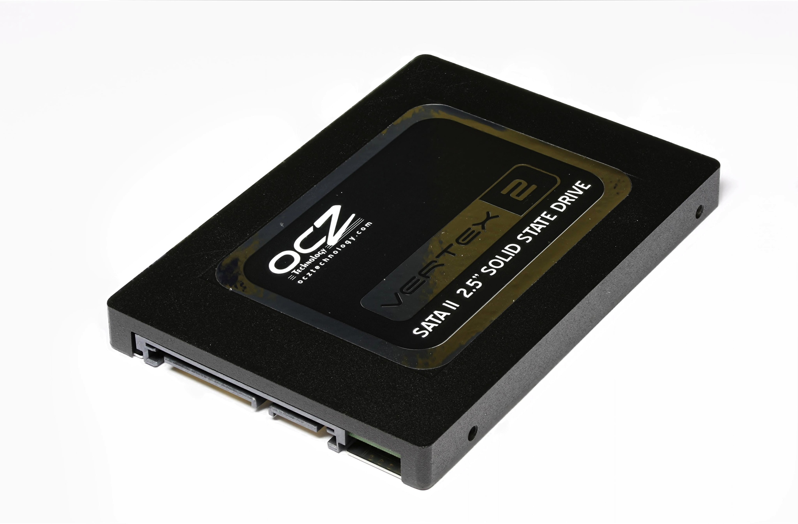
Source: Solid-state drive

Slide 25
Networking

Slide 26
Why Networking?
Sharing data
Sharing hardware
Sharing software
Increasing robustness
Facilitating communications
Facilitating commerce

Slide 27
How did it all start?
How did it evolve?
How did we get here?

Slide 28
Packet vs. Circuit Networks
Telephone system (“circuit-switched”)
Fixed connection between caller and called
High network load results in busy signals
Internet (“packet-switched”)
Each transmission is broken up into pieces and routed separately
High network load results in long delays

Slide 29
Packet Switching
Break long messages into short “packets”
Keeps one user from hogging a line
Each packet is tagged with where it’s going
Route each packet separately
Each packet often takes a different route
Packets often arrive out of order
Receiver must reconstruct original message
How do packet-switched networks deal with continuous data?
What happens when packets are lost?

Slide 30
Different Networks Types
Local Area Networks (LANs)
Connections within a building or a small area
Wireless or wired
Wide Area Networks (WANs)
Connections between multiple LANs
May cover thousands of square miles
The Internet
Collection of WANs across multiple organizations

Slide 31
The Internet
Global collection of public networks
Private networks are often called “intranets”
Use of shared protocols
TCP/IP (Transmission Control Protocol/Internet Protocol): basis for communication
DNS (Domain Name Service): basis for naming computers on the network
HTTP (HyperText Transfer Protocol): World Wide Web
Next week: how does all of this work?

Slide 32
Characterizing Computing

Slide 33
Trends in Computing: #1

Slide 34
Trends in Computing: #2

Slide 35
Trends in Computing: #3

Slide 36
Ways to characterize computing
How big?
How fast?
How reliable?
Computing is fundamentally about tradeoffs!

Slide 37
How big?

Slide 38


Slide 41
How many states can n bits represent?
(or the story of 18,446,744,073,709,551,615 grains of rice)

Slide 42


Slide 43
Data is represented via an encoding
American Standard Code for Information Interchange (ASCII)
= standard byte encoding used in PC’s
01000001 = A
01000010 = B
01000011 = C
01000100 = D
01000101 = E
01000110 = F
01000111 = G
01001000 = H
01001001 = I
01001010 = J
01001011 = K
01001100 = L
01001101 = M
01001110 = N
01001111 = O
01010000 = P
01010001 = Q
…
01100001 = a
01100010 = b
01100011 = c
01100100 = d
01100101 = e
01100110 = f
01100111 = g
01101000 = h
01101001 = i
01101010 = j
01101011 = k
01101100 = l
01101101 = m
01101110 = n
01101111 = o
01110000 = p
01110001 = q
…

Slide 44
Units of Size
Unit | Abbreviation | Size (bytes)
bit | b | 1/8
byte | B | 1
kilobyte | KB | 2¹⁰ = 1,024
megabyte | MB | 2²⁰ = 1,048,576
gigabyte | GB | 2³⁰ = 1,073,741,824
terabyte | TB | 2⁴⁰ = 1,099,511,627,776
petabyte | PB | 2⁵⁰ = 1,125,899,906,842,624
In most cases, it’s okay to approximate!

Slide 45
How small?

Slide 46
Units of Distance
Unit | Abbreviation | Fraction of a meter
meter | m | 1
centimeter | cm | 10⁻² = 1/100
millimeter | mm | 10⁻³ = 1/1,000
micrometer | μm | 10⁻⁶ = 1/1,000,000
nanometer | nm | 10⁻⁹ = 1/1,000,000,000
picometer | pm | 10⁻¹² = 1/1,000,000,000,000

Slide 47
Progression of Technology
Year | Feature Size
1971 | 10 μm
1975 | 3 μm
1982 | 1.5 μm
1985 | 1 μm
1989 | 800 nm
1994 | 600 nm
1995 | 350 nm
1997 | 250 nm
1999 | 180 nm
2002 | 130 nm
2004 | 90 nm
2006 | 65 nm
2008 | 45 nm
2010 | 32 nm
2012 | 22 nm
2014 | 14 nm
How large is a silicon atom?
~0.25 nm

Slide 48
How fast?

Slide 49
Thinking About Speed
Speed can be expressed in two ways:
How many things can you do in one second?
How long to do something once?
Convenient units are typically used
1 GHz instead of 1,000,000,000 Hz
10 microseconds rather than 0.00001 seconds
When comparing measurements, convert units first!

Slide 50
Units of Frequency
Unit | Abbreviation | Cycles per second
hertz | Hz | 1
kilohertz | KHz | 10³ = 1,000
megahertz | MHz | 10⁶ = 1,000,000
gigahertz | GHz | 10⁹ = 1,000,000,000

Slide 51
Units of Time
Unit | Abbreviation | Duration (seconds)
second | sec/s | 1
millisecond | ms | 10⁻³ = 1/1,000
microsecond | μs | 10⁻⁶ = 1/1,000,000
nanosecond | ns | 10⁻⁹ = 1/1,000,000,000
picosecond | ps | 10⁻¹² = 1/1,000,000,000,000
femtosecond | fs | 10⁻¹⁵ = 1/1,000,000,000,000,000
How far does light travel in one nanosecond?
0.3048 m

Slide 52
How fast can we compute?
Computation speed is limited by two factors:
Getting data to the CPU
Operating on the data in the CPU
Two parts of moving data from here to there:
The delay between two locations
Amount of data you can move within a given amount of time
Fundamentally, there’s no difference:
Moving data from the processor to RAM
Saving a file to disk
Watching Netflix

Slide 53
Latency
Units in terms of time
Bandwidth
Units in terms of size per time

Slide 54
Discussion Point
What’s more important: latency or bandwidth?
Streaming audio (e.g., NPR broadcast over Web)
Streaming video (e.g., CNN broadcast over Web)
Audio chat
Video conferencing

Slide 55
How reliable?

Slide 56
Characterizing Reliability
“Nines” | Availability | Downtime (per year)
One nine | 90% | 36.5 d
Two nines | 99% | 3.65 d
Three nines | 99.9% | 8.76 h
Four nines | 99.99% | 52.56 m
Five nines | 99.999% | 5.256 m
Six nines | 99.9999% | 31.536 s

Slide 57
Time to roll up your sleeves…

Slide 58

Server (Web? File?)
Source: http://www.studyzone.org/

Slide 59

Clients
Source: http://www.netofinancial.com/

Slide 60
Why Code HTML by Hand?
The only way to learn is by doing
WSIWYG editors…
Often generate unreadable code
Ties you down to that particular editor
Cannot help you manipulate backend databases
Little help when it comes to Javascript
Hand coding HTML allows you to have finer-grained control
HTML is demonstrative of other important concepts:
Structured documents
Markup
Metadata
…

Slide 61
Tips
Edit files on your own machine, upload when you’re happy
Save early, save often, just save!
Reload browser
File naming
Don’t use spaces!
Punctuation matters!
Case matters!

